Slide 1
IDC R290 3x150g
Next Gen Solution
Project Update
Presenter: SB
Contributors: EW, PA, DD, KR
October 5th, 2017

Slide 2
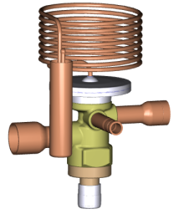
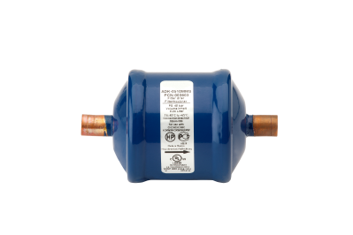
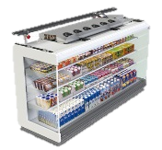
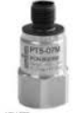
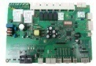
Gen2-150g - New Generation Integral Display Case Solution With Multi-Circuit Fixed Speed <150g
Objectives
Technical Scope
Develop NextGen Solution for R290 Display Case (150gr)
Going beyond today design
Applied cost
Efficiency
Improve design to achieve 3M1 requirements
Use AHT Vento Green 375 L8 as baseline
Solution package including
Compressors (ZB*KAU)
Flow controls (TX, PS)
ECB-D Control Board
Case design recommendations
Evaporator Design
Condenser Design
Fans Control
Accessories (Filters, …)
Complete Safety Concept w/ VDE & UL Approved parts
IP
Team
Timing & Status
SB
KR/DD – Case Design Changes & Testing
EW/PA – Data Analysis & Design Evaluation
Sponsor: RD
Test: Baseline – Completed 03/07/2017
Modif: System Design Improvements – 18/07/2017
Test: 2nd campaign – Completed 28/08/2017
EBM-Papst workshop – 04/08/2017
Modif: ZB*KAU Hybrid Motor – 01/09/2017
Test: 3rd campaign – started 02/09/2017
Next steps
Evaporator change – mid-October 2017

Slide 3
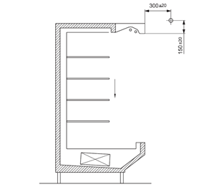
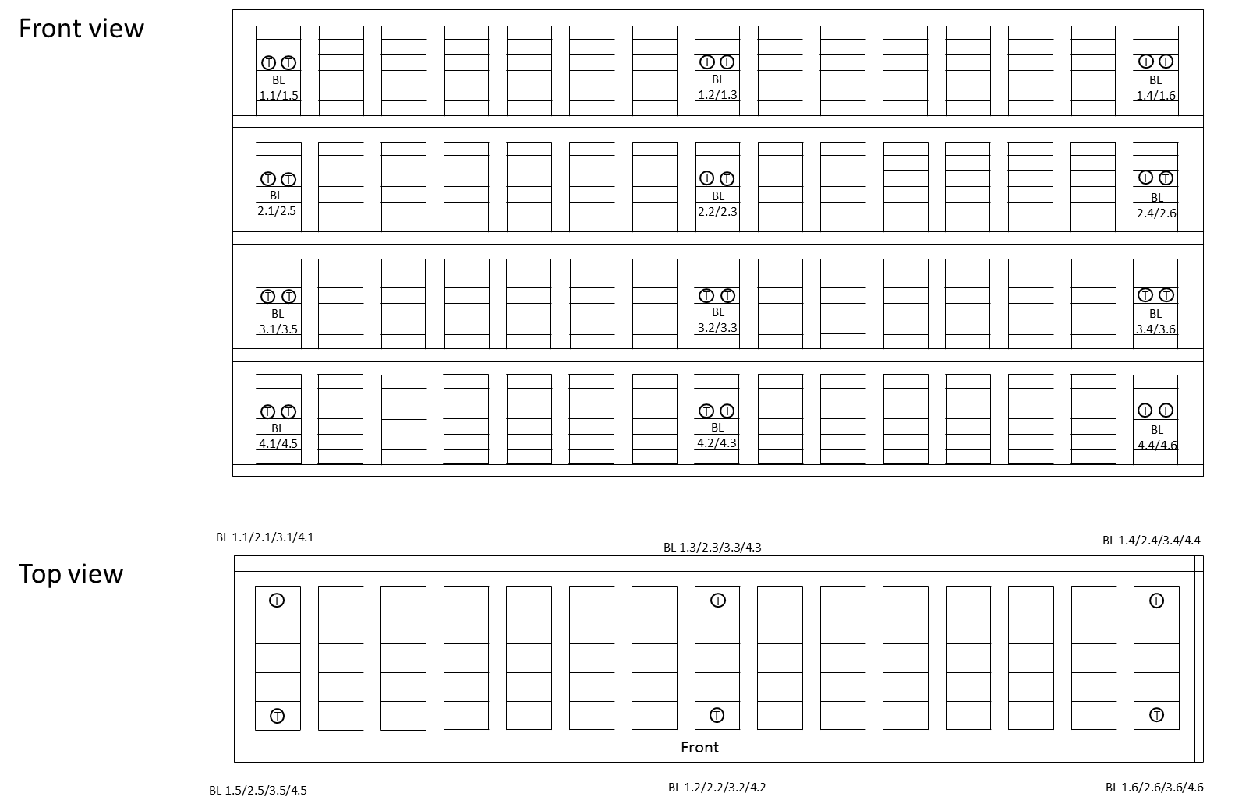
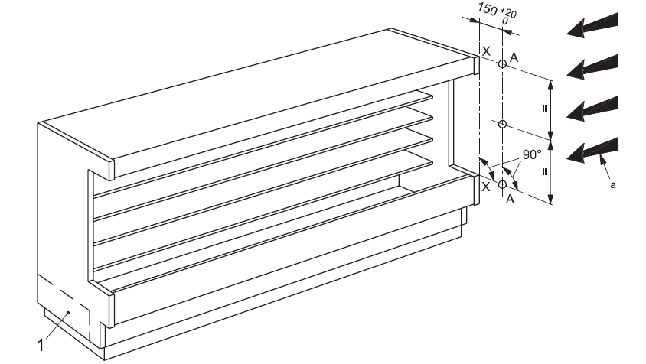
EN ISO 23953-2 Testing Requirements
Conditions | Current Status In Lab | Comments
Climate / Ambient conditions & measurement | OK | To be improved for full compliance w/ ISO 23933 (might lead to better results – tbc)
M-Packages Characteristics | OK | OK
M-Packages Temperature Measurement | Representative but reduced number of measurements points | Keep
Air movement accross cabinet ~ 0.2 to 0.1 m/s | Air speed in line with requirements (0.1 to 0.2 m/s) Air flow not in line w/ requirements but not disturbing significantly case operation (vizualized 19/07) | Improved w/ installation of « ceiling » (09/17). Need accurate speed measurement to adjust room fans speed (Oct 2nd)
Stability & Test period | OK (24hrs) | OK (24hrs is the minimum)
Power measurement | OK | OK
Water Temperature/Flow Control & Measurement | Not described by standard (35°C as reference?). Lidl requires 55°C Improved PID setting to better manage defrost transient (July 17th) | Some erratic behavior occurred. Solved. (Sept 2017) Switched to pure water for more accurate measurement (Aug 2017)
V
Continuous setup improvement to get closer to ISO 23953 requirements.

Slide 4
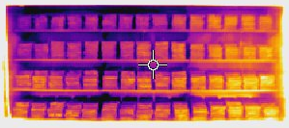
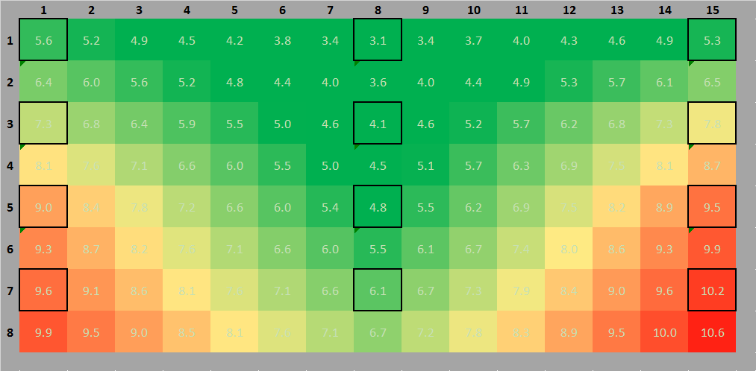
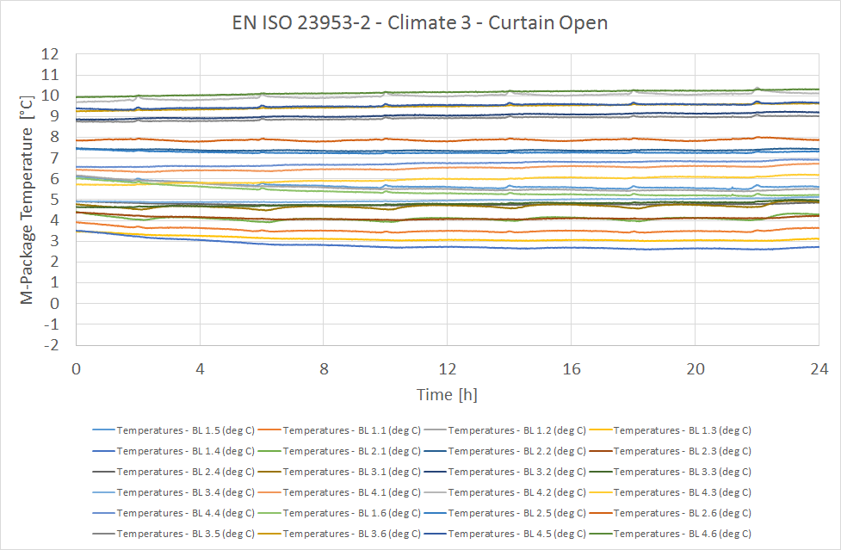
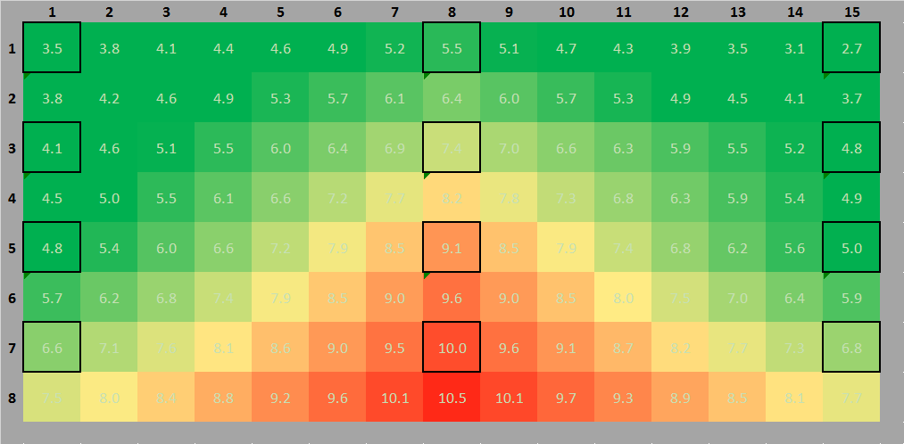
Reminder July 2017 Baseline Test (Climate Class 3)
Test #05
Case Front – Temperature Distribution
H2
M2
M1
Minimal Temperature
Case Back – Temperature Distribution
Lack of Capacity To Cool Down Products
3M1 (-1/+5) Requirements not fulfilled. Case achieved only 3H2 (-1/+10).

Slide 5
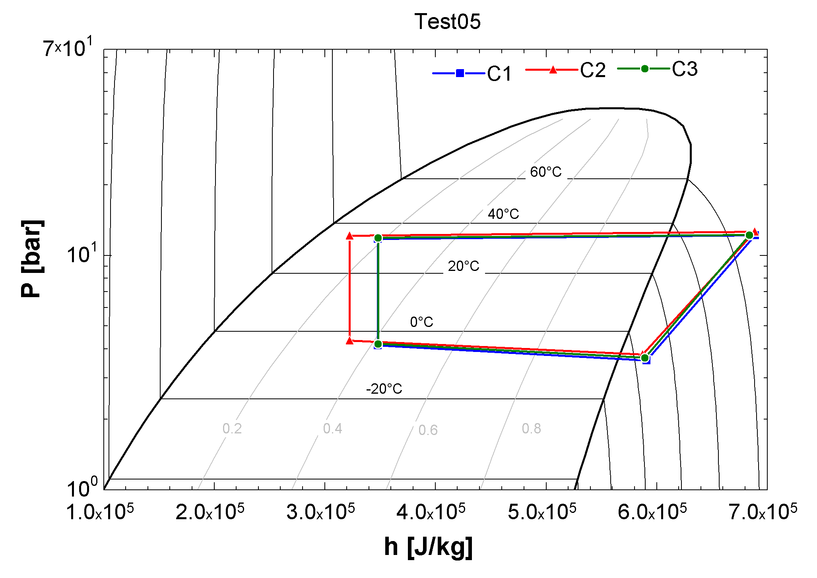
Reminder July 2017 Baseline Test (Climate Class 3)
 |  | Average | Comments
T prod. max | °C | 10.2
T prod. min | °C | 2.7
T prod. Avg | °C | 6.4 | High products temperatures
T prod. median | °C | 5.8
T air in | °C | 10.5 | High return air temperature
T air out | °C | 1.6
Evap. Temp. | °C | -8.1
Superheat | K | 13.7 | High superheat
Cond Temp. | °C | 34.0
Liquid Quality | % | 16 | No liquid at condenser outlet
ΔT cond-water,out | K | -0.1 | Good condenser performance
Cooling Capacity | kW | 6.3 | Limited cooling capacity
Compressor COP | - | 2.4
Acceptable Efficiency Level – Main Limitation For System Efficiency Improvement Are Charge Limitation & Air Curtain

Slide 6
Design Modifications & Results

Slide 7
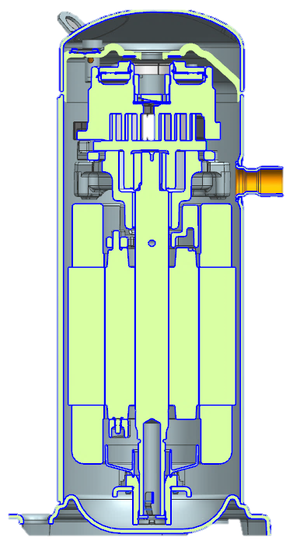
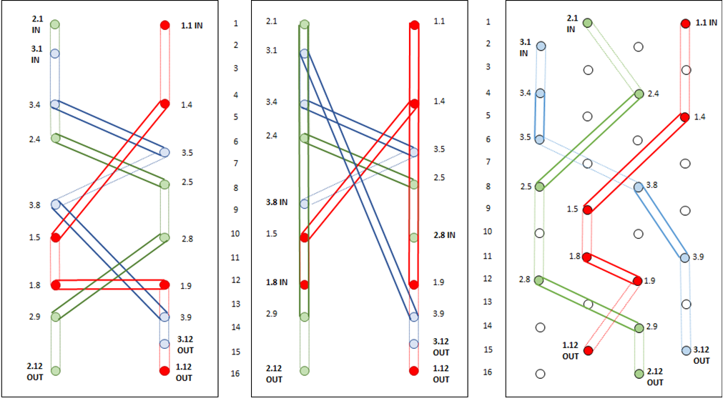
Summary Of Design Modifications
Phase 1 - Circuit
Phase 2 - Compressor
Phase 3 - Evaporator
Circuit Design Improvements
Condenser w/ smaller internal volume (SWEP)
New expansion valve
Evaporator circuit optimization
Variable Speed Fans
Control Improvements
Demand defrost
New compressor design
“Hybrid Motor”
Evaporator Design Improvements
Internal volume reduction
Optimal piping
Distributor ?
Initial Design
Circuit
Optimization
New Design?
100% Completed
80% Completed
Start Mid-October

Slide 8
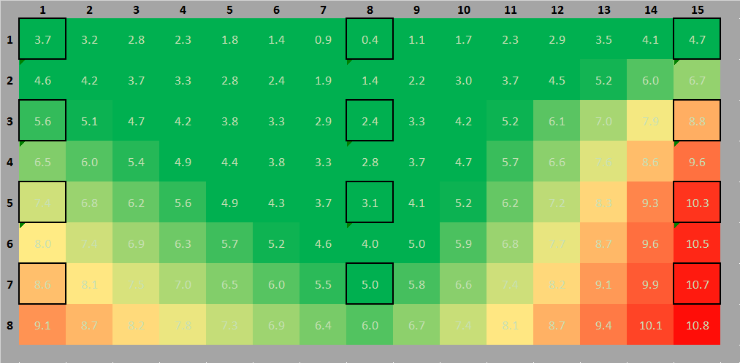
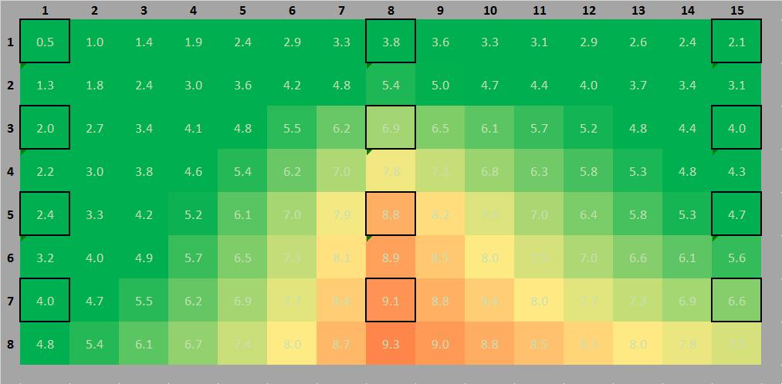
Phase 1 – Results Impact of Circuit Design Modifications
 |  | Baseline | Test 18 | Comments
T prod. max | °C | 10.2 | 10.7 | Lower products temperatures (-1.2°C in average)
T prod. min | °C | 2.7 | 0.5
T prod. Avg | °C | 6.4 | 5.2
T prod. median | °C | 5.8 | 4.7
T air in | °C | 10.5 | 8.6 | Lower air temperatures
T air out | °C | 1.6 | -0.7
Evap. Temp. | °C | -8.1 | -10.1
Superheat | K | 13.7 | 9.0 | Lower superheat
Cond Temp. | °C | 34.2 | 34.8
Liquid Quality | % | 16% | 11% | Still no liquid at condenser outlet
ΔT cond-water,out | K | -0.1 | -0.1 | Equivalent ΔT w/ less volume
Cooling Capacity | kW | 6.3 | 6.0 | Still limited cooling capacity
Compressor COP | - | 2.4 | 2.2 | No COP gain due to lower evap. temp.
Case Front – Temperature Distribution
Case Back – Temperature Distribution
Improved Circuit Design Allowed Better Use Of Evaporator & Better Cooling Down Of The Products

Slide 9
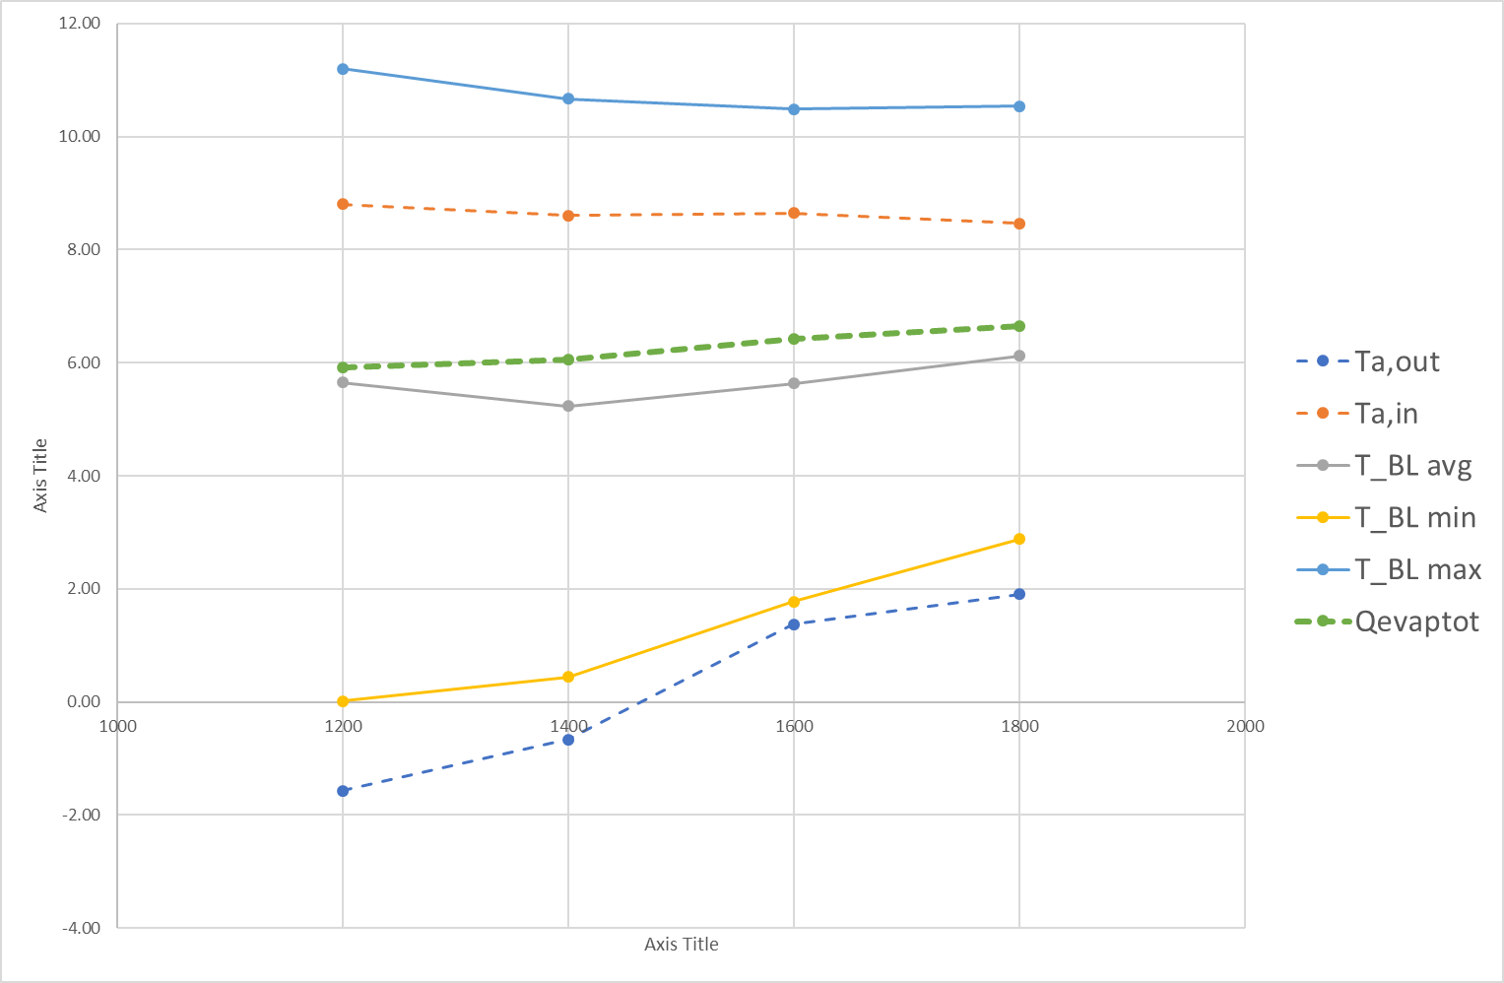
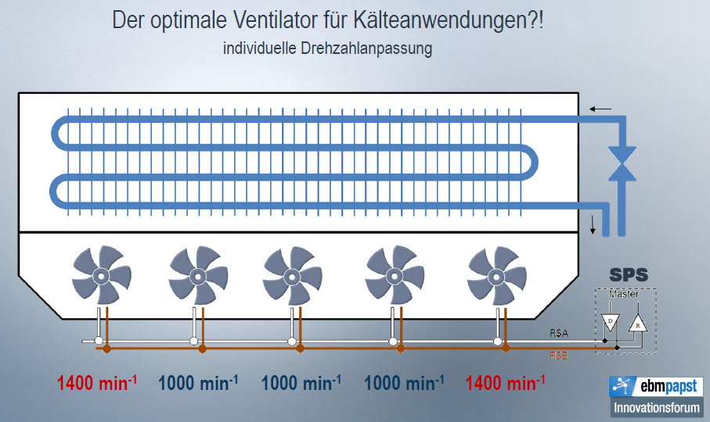
Phase 1 – Results Impact of (Modbus) Variable Speed Fans Control
1
Test w/ Unbalanced Speed Profile
Result: No measurable improvement
Reasons: 6 fans blowing in same open plenum. Working only in cases w/ modular evaporator design
Solution: Would require significant modification of AHT design
Test w/ Lower/Higher Speeds
Optimum is 1400rpm (nominal)
Low speed → Product freezing
High speed → Too high evap. Temp.
2
2
1
1
2
3
Fans speed adjustment did not results in better cooling performance or efficiency. Air flow distribution & Air curtain are key.

Slide 10
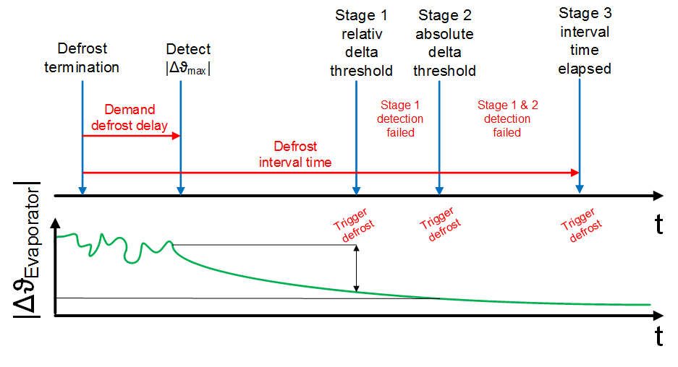
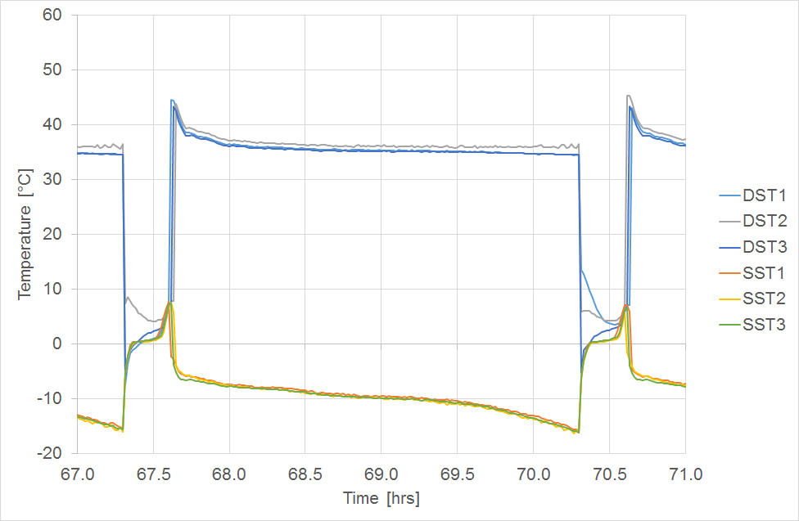
Phase 1 – Results Impact of Demand Defrost Logic
Default (Today): Time Defrost
Time interval (e.g. 3 to 4 hours) is usually optimized for one given operating condition
Limitations: Defrost can start too late (coil fully frozen) or too early (unnecessary defrost). Impossible to tune for every store/climate/season.
Improved: Self-Learning Demand Defrost
Principle: Detection is based on air-fin-product temperatures. Algorithm is learning
Gain: Defrost is triggered when needed.
Patent Pending
The right time for defrost
OK: 8°C evap
KO: evap -15°C
Demand Defrost Allows To Run Defrost When It Is Required
Need More Tests To Quantify Benefit

Slide 11
Phase 2 – Results Impact of Compressor Change
Calorimeter Testing (July 2017)
Display Case Testing
Gains resulting from motor change (“Hybrid motor”) and oil change (3MAF instead of HatCol)
Power decreases (especially at low condensing)
Slight capacity drop at high condensing. COP variation remains positive.
Similar operating conditions before & after (but no direct control)
No oil return issue
Questions:
Does capacity drop impact case performance ?
Does oil solubility variation impact case performance ?
Variation in condenser performance ?
Condition Class 3 - 25°C/60% | P (W)
Low Condensing | N/A
Med. Condensing (Water 30/35°C) | -8.8%
High Condensing (Water 50/55°C) | -1.4%
Condition SH10K/SC0K | P (W) | Q (W) | COP
-7/15°C | -16.6% | -0.2% | 19.6%
-7/35°C | -9.5% | -0.8% | 9.5%
-7/55°C | -4.2% | -3.1% | 1.2%
Efficiency gain due to lower power consumption is confirmed.
Further tests needed to evaluate potential impact of oil change

Slide 12
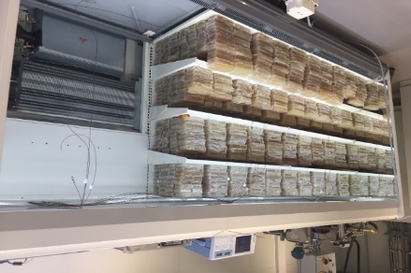
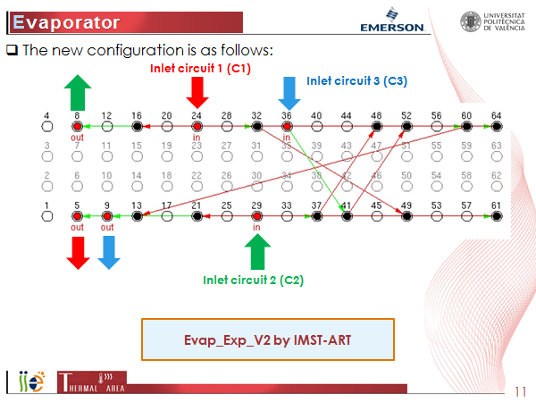

Phase 3 – Plan Evaporator Design Change
Evaporator Improvements
Reduce effective pipe diameter (10mm to 7mm?) to reduce amount of charge in evaporator
Not a limitation from suppliers (source: Karyer, LUVE, Guentner…)
Limitation comes from OEMs (using std HFC coils)
Increase counter flow effect
Increase cross-flow effect by using more rows (4 instead of 2)
Use distributor ?
Plan
Finalize design change based on UPV’s inputs
Use evaporator coil received from Lidl stock
Same size & shape
4 rows / 32 pipes (10mm)
Not all pipes are used (flexibility)
Reduce inner volume using “dead-volume”
FY18Q1
Initial Design
Circuit Optimization
New Design?

Slide 13

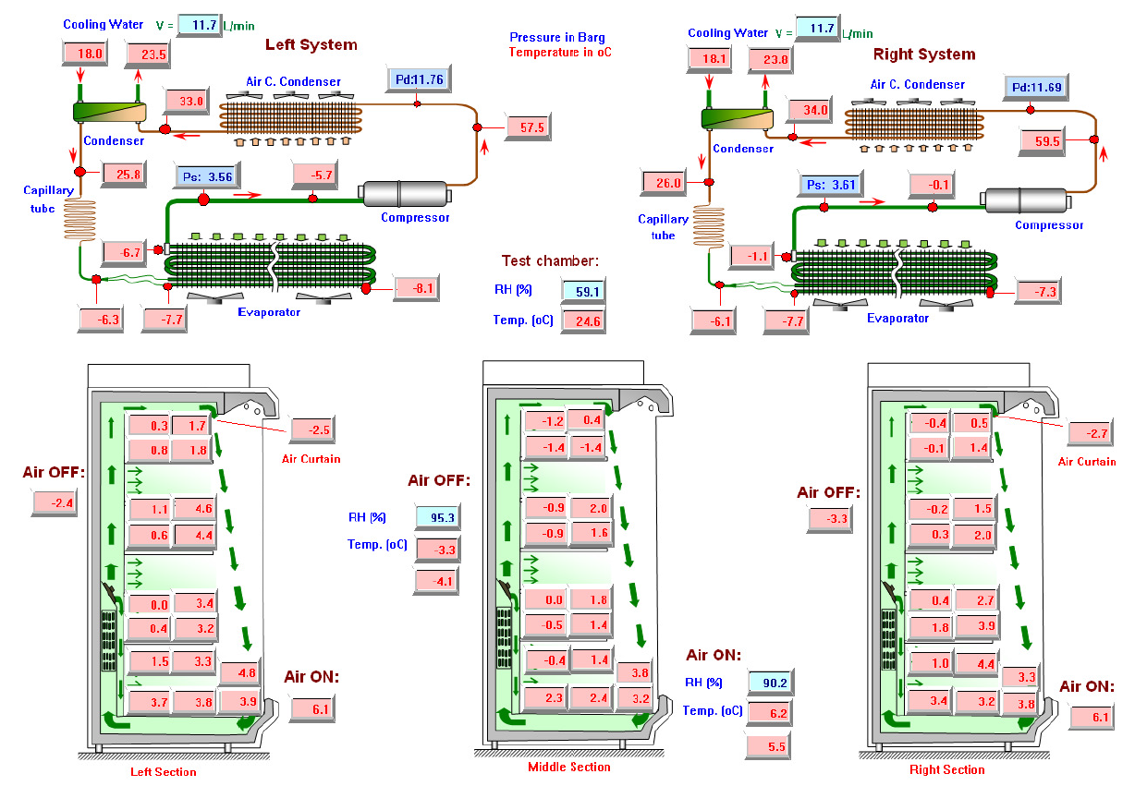
External Information: Arneg – Brunel University 2011 Test Report – IDC 3.75m w/ R1270
Test report from Brunel University (London, UK)
3.75m Open Display Case (“Berlino”)
Single air curtain + 6 fans
2 circuits w/ Horizontal Hitachi DS1529S1
R1270 (0.720 kg) – no charge optimization
Achieved 3M1 & 3M0 by optimizing panels design & air flow
Key Learnings
3M0 & 3M1 achievable w/ open 3.75m case
Cooling capacity need ~ 8 kW (@-7/30)
Air Flow distribution & panel design is key
COP: ZB*KAU vs Hitachi Scroll ~ +18%
Display case test protocol
Note: Brunel University has long experience in Multideck Display case modelling, testing & optimization. Interesting potential partner for external design review/assessment.

Slide 14
Conclusions & Next Steps
Fine-tune test setup (9th Oct)
Room air speed adjustment
Monitoring setup verification
Finalize current test campaign (“Hybrid Motors”) to validate results (Oct 16th)
Evaporator Change (Oct 23rd)
To start second half of October
Use available coil provided by Lidl as basis.
Refine Selection Of Expansion Device (Oct 23rd)
Electronic valves are used for lab testing (flexibility)
External
Get in touch w/ Burnel University for external design review (Oct 16th)

Slide 15
backup

Slide 16
EBM Variable speed Modbus fans Unbalanced fans speed control
Target: Improve temperature distribution in the cabinet
Results: no measurable improvement in terms of distribution nor avg product temperature
Reason: Common plenum after the fans equalizes static pressure and hence flow distribution through the honeycomb
Solution: Need to separate the fans per channel with baffles
Works only in the case of separate modular evaporators/circuits (confirmed by EBM Papst- Meeting 4Th of August)

Slide 17
EBM Variable speed Modbus fans All fans from 1200 to 1800rpm
Qevap increases slightly with fan speed 1
Best product temperature at …1400rpm – same as fixed speed fan 2
T_a_out getting too low at low speed (risk of products freezing) 3
1
2
3

Slide 18
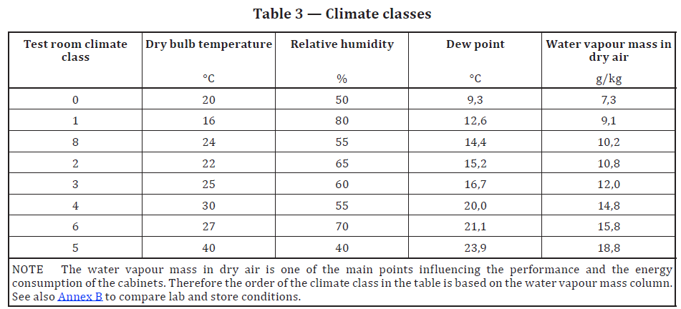
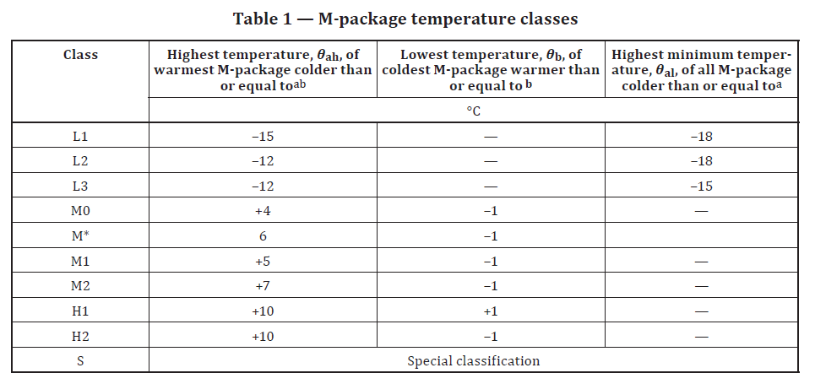
Scope
Energy Efficiency
Case Temperature Category
Look at total energy use (kWh) in continuous operation (24hrs)
Definitions (Lot12 & EN ISO 23953-2)
TEC = Total Electrical Consumption [kWh]
TDA = Total Display Area [m²]
Eff = TEC/TDA = Case Efficiency [kWh/m²/day]
EEI = Energy Efficiency Index = Eff/Eff_ref*100
Key Factors influencing efficiency
Cabinet cross-section & configuration of shelves • the air flow configuration
Lighting, night curtain, doors (closed cabinets)
Evaporator & condenser design
Refrigerant charge
Compressor efficiency
Superheat Control
Fans efficiency & operation
Defrost management
Defined and certified according to EN ISO 23953-2
Climate Classes (Ambiant Conditions)
3: 25°C/60% (standard for Europe - LIDL requirement)
Temperature class (Food Temperature)
M1: Highest product < +5°C & Coldest product > -1°C (LIDL requirement)

Slide 19
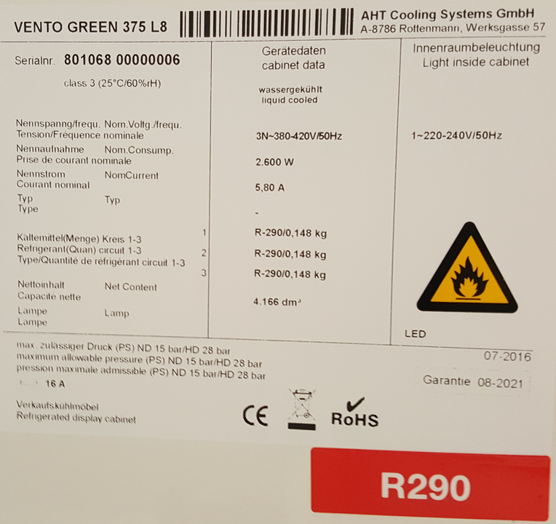
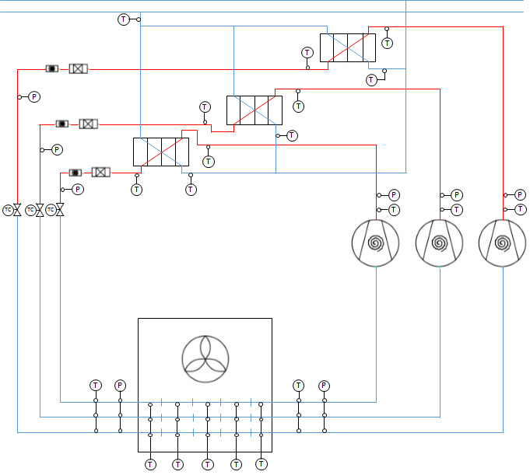
Test Setup
Display Case:
AHT Vento 375 L8 – R290
Test Environment:
Psychrometric Chambers A & B
Case load w/ M-packages
Case Dimensions |  | Unit | Value
horizontal projection of the open surface | H0 | m | 0.2
cabinet lenght without end walls of the horizontal open surface | L0h | m | 3.76
horizontal projection of the glazing surface | Hg | m | 0
cabinet lenght without end walls of the horizontal glazing surface | Lgh | m | 3.76
vertical projection of the open surface | V0 | m | 1.55
cabinet lenght without end walls of the vertical open surface | L0v | m | 3.76
vertical projection of the glazing surface | Vg | m | 0
cabinet lenght without end walls of the vertical glazing surface | Lgv | m | 3.76
Total Display Area | TDA | m² | 6.58

Slide 20
Case Design Improvements & Work Plan
-5/45/10K/0K |  | Baseline | Improved | Energy Efficiency | Temperature Class | Step 1 (July) | Step 2 (August)
Compressor | Motor | ZB09KAU | ZB09KAU* Hybrid Motor | +++ | 0 |  | V
 | Size |  | New displacement (+/- 20% w/ inverter) | 0 | 0 (?) | V
 | Oil | HatCol | 3MAF | ++ | 0
 | Free Volume | Standard | -50% | ++ | ++ |  | Feasibility
Fans |  | Fixed Speed | EC Fans | ++ | + (?) | V (Trial & Error)
Filter Drier |  | Danfoss DML 1.52X2/2S | Parker | 0 (?) | 0 (?)
Condenser - PHX | Type | Danfoss D22-20 | SWEP (20) | + (?) | + (?) | V
Evaporator Coil | Configuration | Original | Parker Distributor 1-to-3 | + (?) | 0 (?)
 | Model | Original | New Design | + (?) | + (?) | Design w/ manufacturers | Test
 |  |  | Improved counteflow effect
Expansion Valve | Type | Honeywell TLK-E1016 | TIH or TX3 (variable w/ EXM) | N/A | N/A | V EXM-BOE
 | Location | Evaporator Inlet | Condenser Outlet | + | + |  | ??
Air Flow Distributors |  | Today Air Curtain | Improved (Trial and error) | + (?) | + (?) | V (Trial & Error)
Defrost Control | Demand Defrost Control |  |  | + | 0
Room Upgrade | Air flow & Water Flow management |  |  |  |  | Evaluate & Quote
Focus on achievable inner volume reduction, air distribution & efficiency improvements. Impact on temperature class is hard to predict and will be evaluated during tests

Slide 21
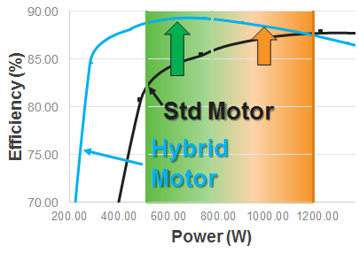
ZB*KAU - Compressor Design Improvements
Energy Efficiency Gains
R290 Charge Improvements
High Side ~ 14gr R290
Free Volume 0.34L
Hybrid Motor
Decreasing free vol. 95% (direct discharge) could gain about 13gr.
/!\ Pulsations in discharge line
ΔCOP > +5%
Low Side ~ 12gr R290
Free Volume 1.62L
Decreasing free vol. 50% could gain about 6gr
Oil Change
Hatcol4467 to 3MAF
Refrigerant diluted in the oil ~ 37gr for 0.74L
V
ΔCOP +4.3% to +1.1%
Cost Reduction
ΔDilution +3%
Oil charge has been reduced from 0.74L to 0.47L
Reduction of R290 diluted in oil from 37g to 23.8g
Done
On-Going (Release Nov 2017)
Done

Slide 22
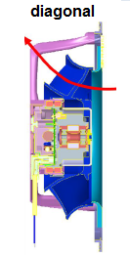
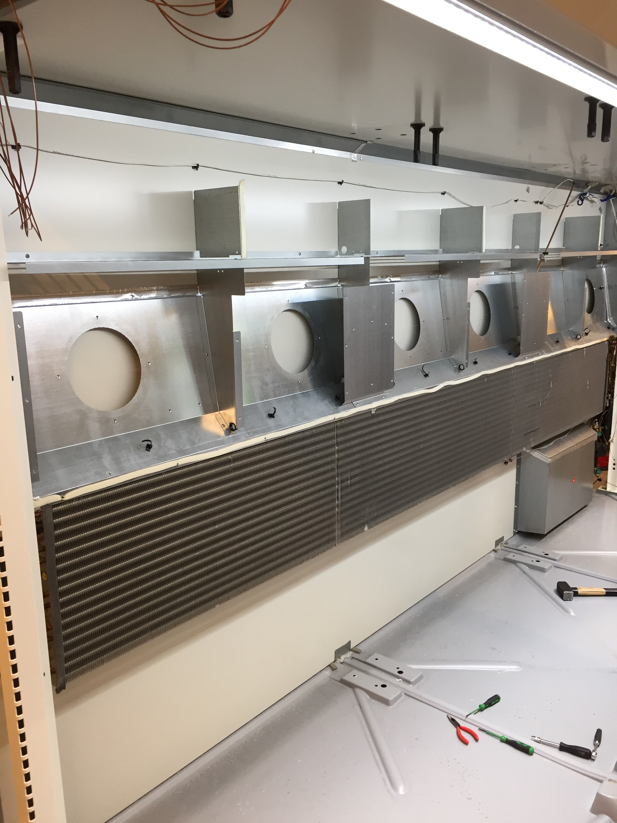
EC Fans
Objective
Unbalanced fans speed control for improved temperature distribution in DC
Existing: K1G200-AA89-12 (Two-speeds 1200-1400rpm)
New: K1G200-AA60-XN (EC Fans – up to 1800rpm)
Notes:
Decision to keep current fan-evaporator configuration (fans on top – coil at bottom)
NDA w/ ebm-papst under preparation
Emerson-EbmPapst workshop scheduled in AAC (August 4th, 2017)
EC (Variable Speed) Fans Being Implemented
Target to improve temperature distribution in the cabinet

Slide 23
Refrigerant Charge Gains & Losses
Condition: -5°C EVAP, 45°C COND, 10K SH, 0K SC
Component | Before | Alternative | Delta / % on 150g
Compressor - free volume | 22.9 g | 11.5g | -11.4g / -7.6%
Compressor - oil dilution | 0.47L Hatcol 23.8 g | 3MAF 24.6 g | +0.8g / +0.5%
Filter Drier | 16.5g | ALCO: 33.0g | +16.5g / +11.0%
 |  | Parker: | Equivalent ?
Condenser (liquid 35%) | 35.5g | SWEP x28: 48.0g | +12.5g / +8.3%
 |  | SWEP x20: 32.0g | -3.5g / -2.3%
Liquid Line (move up TXV up) | 8.2g | 2.4g | -5.8g / -3.9%
Evaporator (liquid 30%) | 145.2g | With distributor | To be evaluated/tested
New evaporator design |  |  | To be evaluated/tested
Focus On Changes Bringing Charge Gains.
Need To Quantify Gain & Feasibility of Compressor Design Improvement

Slide 24
New Evaporator Design – Status
Evaporator Coil Specification established based on baseline results
General requirements first
Provide more info on current design upon request
TO BE UPDATED
Supplier | Circuits | Distributor | Length | Tube Diameter | Tube Thickness | Row x column | Fin Space | Tubes Surface | Internal Volume | Comment
Original (KARYER-AHT) | 3 | NO | 3.4 | 10mm |  | 9 x 2 (16 x 2) | 5mm | 0.64m² | 1.30 l | Standard HFC design
Modified (KARYER-AHT) | 3 | NO | 3.4 | 10mm |  |  | 5mm | 0.64m² | 1.30 l | Improved Counterflow effect
EPTA – SEST | 3 | YES | 2.3 | 7mm |  | 12 x 4 |  | 1.21m² | 1.67 l | EPTA – NDA (Confidential)
REFRION (via ROLLER) | 3 | NO | 3.4 | 10mm |  |  |  | 0.61m² | 1.28 l | No improvement expected
LUVATA
Thermofin | 3 | YES | 3.4 | 5mm |  | 20 x 6 | 4mm? | 2.14 m² | 2.07 l | Prototype to be ordered 6 weeks lead time
Sierra |  |  |  |  |  |  |  |  |  | New [EW]
HTS / LUVE |  |  |  |  |  |  |  |  |  | New [EW]
GUETNER |  |  |  |  |  |  |  |  |  | On-Hold
Friterm |  |  |  |  |  |  |  |  |  | New [FR]

Slide 25
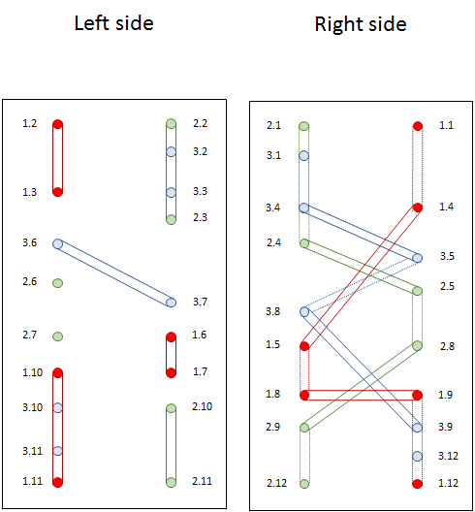
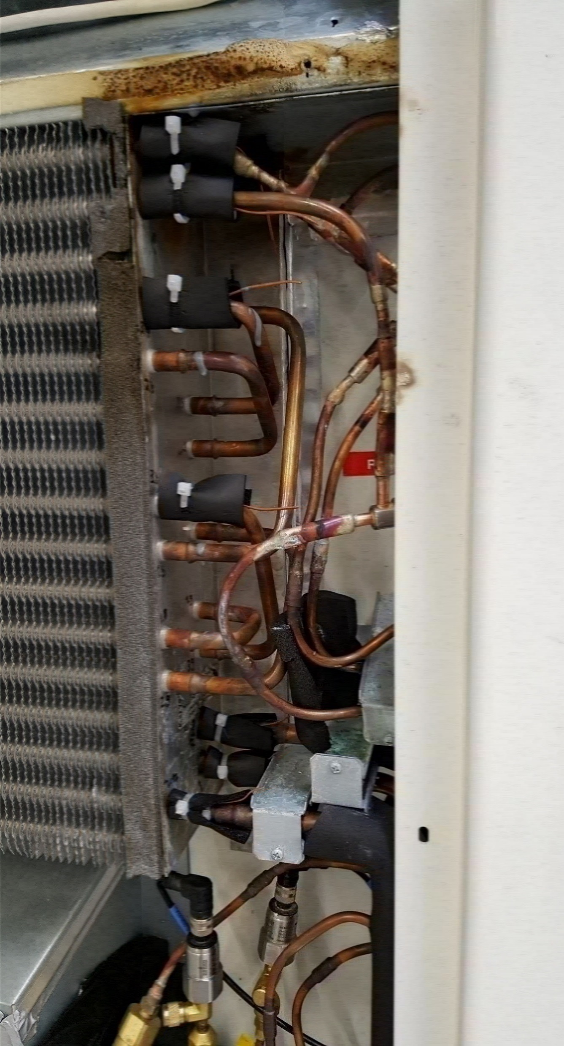
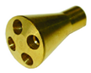
Evaporator Design Improvement
Current Design
Proposed Design
3 circuits with 6 passes
long evaporator pipe length per circuit
high pressure drop
Distribute each circuit 3 times to two passes
shorter pipe length per circuit
Lower velocity
Target reduction of pressure drop & increased evaporator effectiveness
Expected positive impact on efficiency
Impact on cooling capacity is hard to predict (Test Needed)

Slide 26
Fan Curve Assuming Sensible Heat Exchange Only
Baseline (#5) – K1G200-AA89-12 (1400rpm)
Power (6 fans): 70.95 W – 11.83 W/fan
Flow: 0.52 m³/s – 1868 m³/h
Baseline (#45Hz) – K1G200-AA89-12 (1400rpm)
Power (6 fans): 70.81 W – 11.80 W/fan
Flow: 0.51 m³/s – 1810 m³/h
New (#18) - K1G200-AA60-XN (1400rpm)
Power (6 fans): 74.28 W
Flow: 0.42 m³/s – 1508 m³/h

Slide 27
EBM-Papst – Emerson / Meeting notes (August 4th, 2017)
Comments
Unbalanced fan speed distribution can help if air « channels » are properly separated. In current design, all fans are blowing through a « plenum » so unbalanced fan speed is not bringing significant improvement. « Plenum » effect is enhanced by the « wafel » plate
Diagonal fans help because of less « directed flow »
Current configuration (fans « sucking » air through coil) is better from an air distribution point of view
Mixed-flow (diagonal) flow have steeper Pa-qv flow characteristic curve → flow is less sensitive to pressure drop variation (e.g. frost formation)
Deflector behind honeycomb might be optimized. Evaluate possibility to remove it or re-position it (change curvature?)
Benefit/effect of double air curtain is confirmed based on Ebm-Papst experience
Compressor box is blocking a significant section of air channel
Sharp edges should be avoided
Increase speed & isolate section could help compensating this effect and increasing the flow
Actions
Store plenum & opened case pictures on server (KR)
Check recommendations in ISO 23953-2 about m-pack position (e.g. distance from panels or shelf border)
Need to consolidate test data (evaporator heat transfer balance) to estimate fan operating point
Averaging period has some impact due to frost formation
Go-back to Ebm-Papst team to evaluate w/ fans characteristic curves
Air curtain seems perturbated at the bottom and « pushed » from the back of the case. Need to evaluate impact of speed at air inlet (e.g. increase by reducing cross section) and air « injection » from the back panel
Evaluate possibility to provide 3D drawings to Ebm-Papst to run CFD simulations
500gr project: Get back to Ebm-papst w/ fan specification of ELCO fans for selection of EC-fans (axial fans would remain better here)

Slide 28
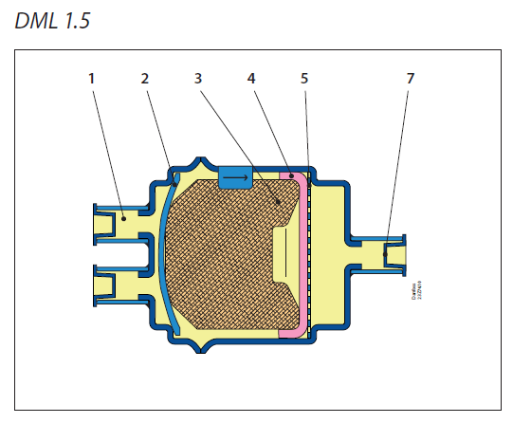
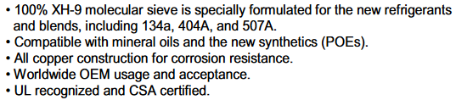
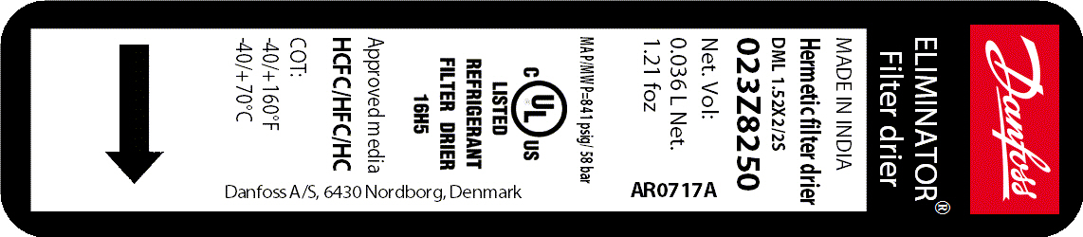
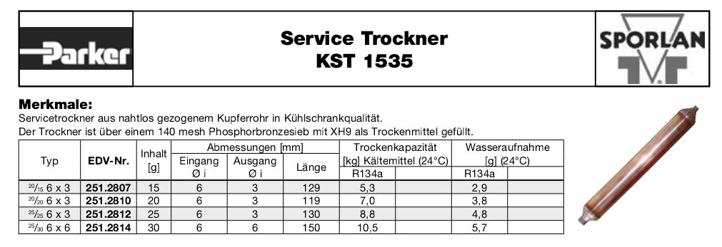
Filter Drier Alternatives

Slide 29
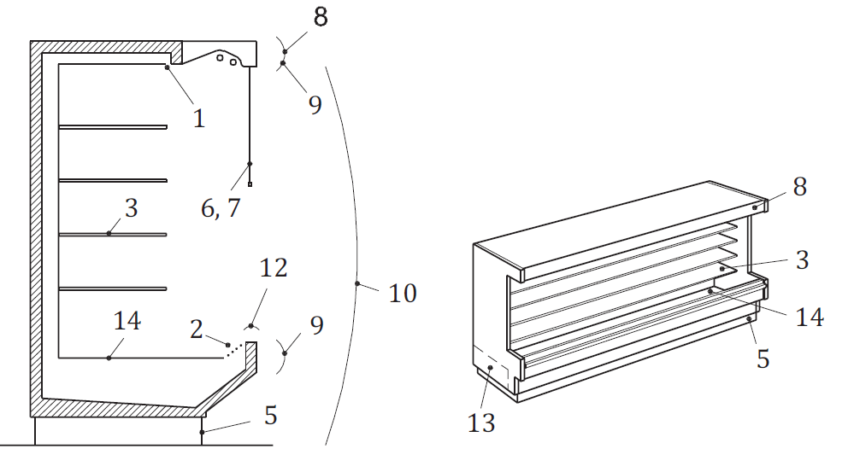
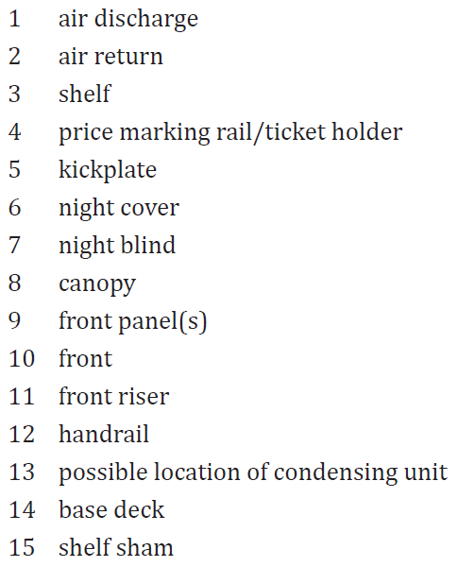
Relevant Standard - EN ISO 23953
Coding Definition
Over 100 types & configurations
Example : IVC2 (Integral – Vertical – Chilled products – Multi-deck)
Definitions
Climate Classes (Ambiant Conditions)
0: 20°C/50%
8: 24°C/55%
3: 25°C/60% (standard for Europe - LIDL requirement)
Temperature class (Food Temperature)
M1: Highest product < +5°C & Coldest product > -1°C (LIDL requirement)
M2 : Highest product < +7°C & Coldest product > -1°C
H2 : Highest product < +10°C & Coldest product > -1°C
Energy Consumption
TEC = Total Electrical Consumption [kWh]
TDA = Total Display Area [m²]
Eff = TEC/TDA = Case Efficiency
EEI = Energy Efficiency Index = Eff/Eff_ref*100

